Slide 1















Bug Tracking System
Presented by theeBugger$
Ayush Jain Sakshi Dherange Venkatesh Joshi Abhiraj Kamal Vishisht Ved Sam Abhraham Joshy Maitreyee Khunte

Slide 2

Project Overview
Development of an online bug tracking system.
Streamlined process for identifying, reporting, assigning, and resolving software bugs.
Implementation of features for testers to inspect, report, and track bugs throughout their lifecycle.
Separate role-based access for smooth workflow and accountability.
Bugs are assigned to teams upon reporting, ensuring they are tracked and associated accordingly.
Bug priority tracking implemented to emphasize severity levels, helping to prioritize and resolve issues efficiently.
A comprehensive solution that enhances team collaboration, improves project management, and accelerates the bug resolution process.

Slide 3
Problem Statement
Current Bug reporting are disorganized, leading to delay in identifying and addressing issues.
Without a unified system, tracking bug status across different team members and projects and prone to errors. Disjointed communication between testers, developers, and project managers can result in mismanaged priorities and overlooked bugs.
To address this, we have developed this online bug tracking system for projects where software testers can report bugs, project managers can view all reported bugs and assign them to developers, and developers can update the status of the bugs as they work on resolving them.

Slide 4
Goals and Objectives
GOALS
Enhance Bug Tracking Efficiency: Streamline the process of identifying, reporting, and resolving software bugs to improve overall project quality.
Improve Team Collaboration: Facilitate better communication and coordination between testers, developers, and project.
Ensure Accountability: Provide clear, traceable actions for all roles involved, ensuring that bugs are addressed promptly and effectively
SHORT-TERM OBJECTIVES
Develop Core Functionalities: Implement the primary features such as bug reporting, assignment, and status tracking for all user roles.
Design User Interface: Create an intuitive and responsive UI for easy navigation and role-based interactions.
Implement Role-Based Access: Ensure that users have appropriate access and functionalities based on their roles (Tester, Developer, Project Manager).
LONG-TERM OBJECTIVES
Scalability and Integration: Ensure the system can scale to handle multiple projects and integrate with other project management tools.
Continuous Improvement: Gather user feedback to refine features, improve usability, and add new functionalities as needed.
Performance Optimization: Optimize the system for speed, reliability, and ease of use, ensuring it remains effective as the number of users and projects grow.
SUCCESS MEASUREMENT
User Adoption Rate: Monitor the number of active users and their engagement with the system.
Bug Resolution Time: Track the average time taken to resolve bugs before and after the system's implementation.
User Satisfaction: Collect feedback from users (Testers, Developers, Project Managers) to assess their satisfaction with the system’s features and usability.

Slide 5
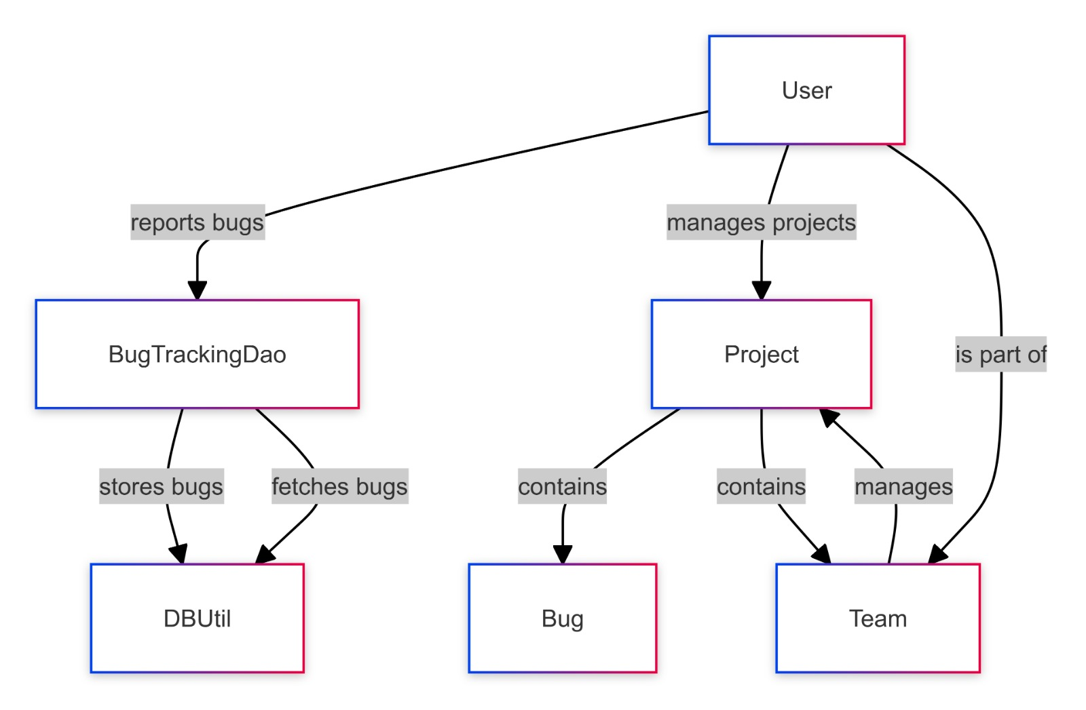
DataFlow Diagram

Slide 6
Security
Encryption is added as a functionality in this project meaning data is encrypted while going to the server.
The encryption is done using RSA in the areas like user credentials, sensitive project data and bug reports.
This encryption of data ensures data integrity and confidentiality, which may impact on protecting data from unauthorised access and data breaches.

Slide 7
Role-Based-Access(RBA)
LOGIN
Test different login scenarios and fetching user information.
Tester
Focuses on scenarios related to bug management and reporting.
Manager
Tests scenarios specific to managers, such as project creation and assigning bugs to teams.
Developer
Focuses on fetching project details, assigning bugs to tester and marking bugs for closure.

Slide 8

Final Reflections and Future Scope
This bug tracking system can be modified and enhanced for performing more complex task related to bug tracking system.
There are many more enhancements that are pending to make this project more interactive and professional, apart from this online facility, chat room, SMS alerts to the user and a separate account will be created for the testing team to compare severity of the incoming bugs.

Slide 9
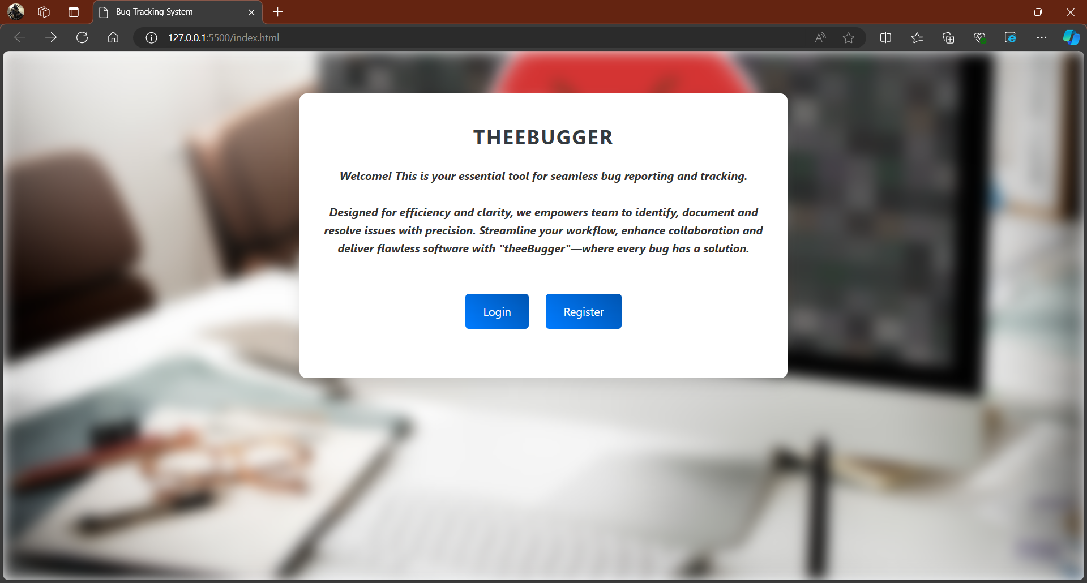
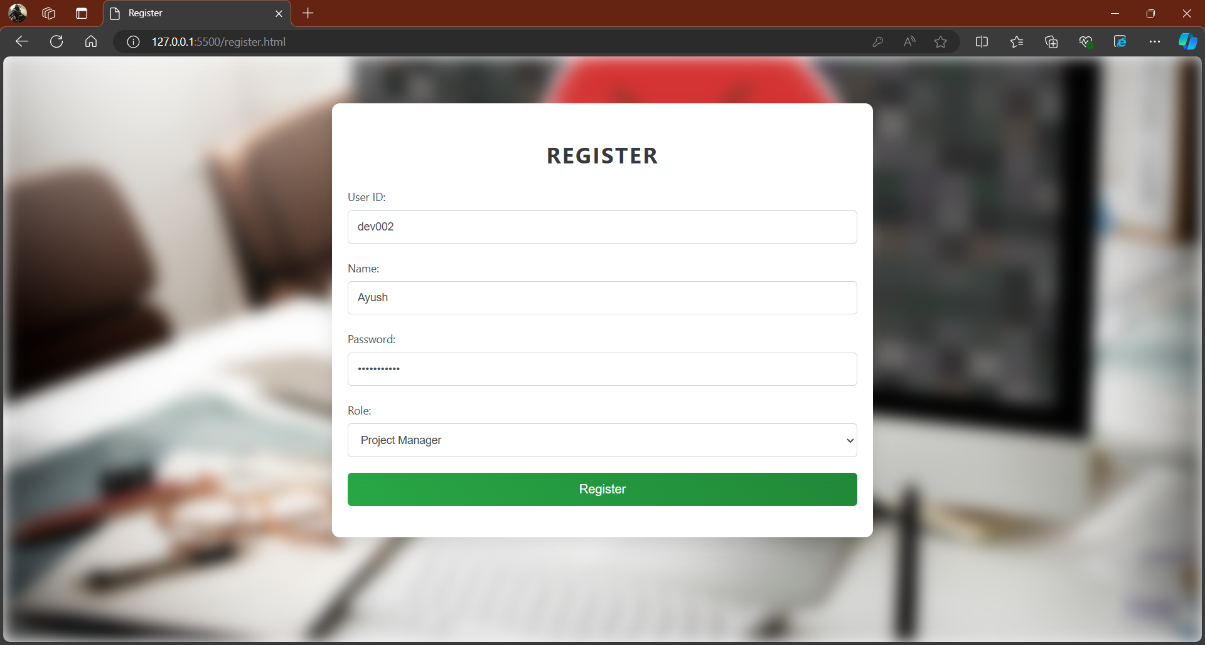
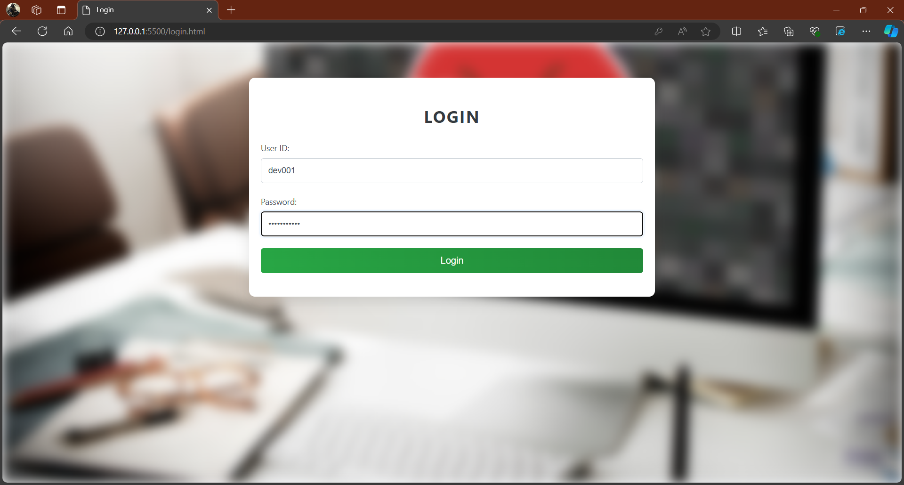
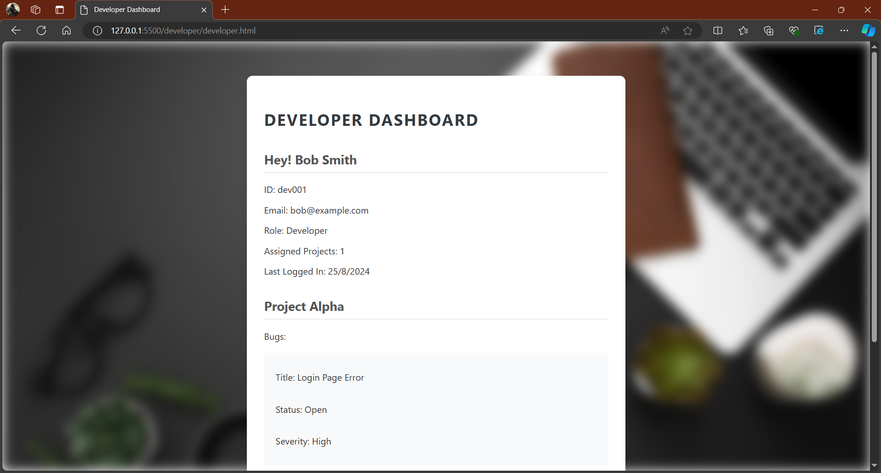
Frontend Implementation

Slide 10
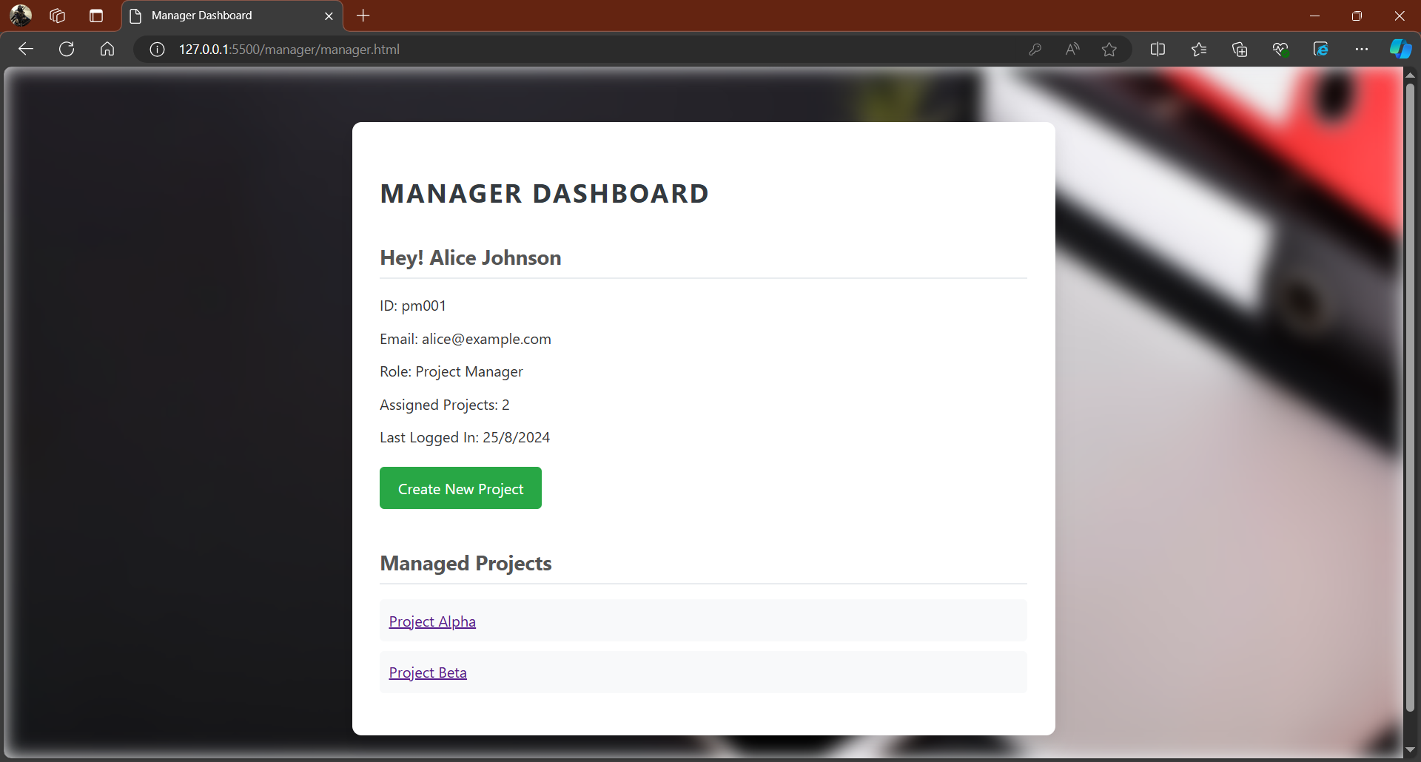
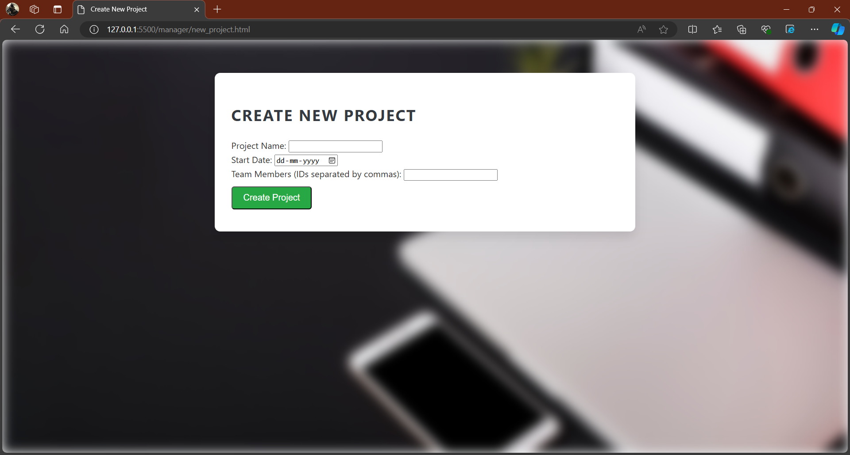
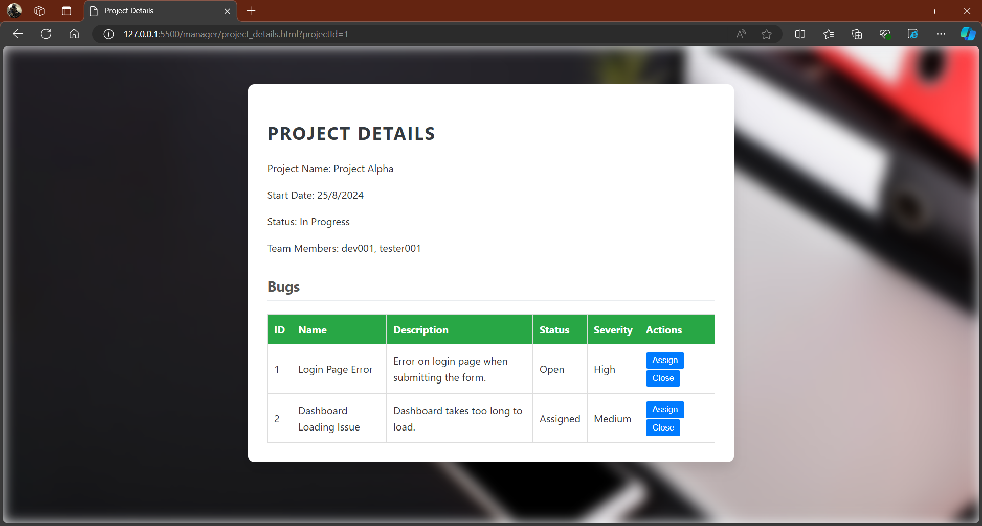
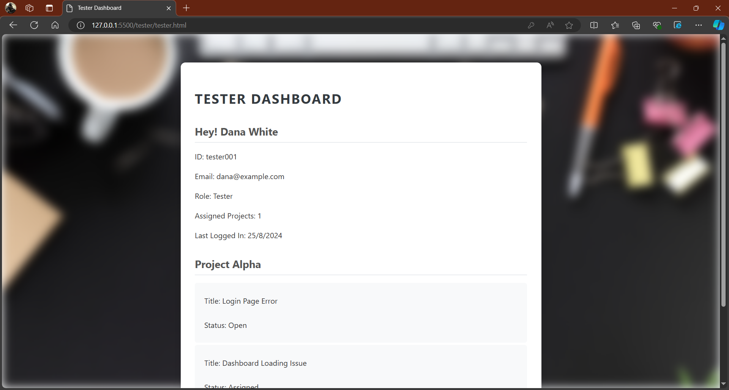
Frontend Implementation

Slide 11
Learnings
Concepts
While working on this project, we deepened our understanding of layered architecture, which helped us organize the system into distinct layers with clear responsibilities, improving the overall design and maintainability.
This approach enabled us to separate concerns and manage complexity more effectively.
Tools and Technologies
We utilized a variety of tools and technologies throughout the project. HTML and CSS were employed to design the user interface, ensuring a user-friendly experience.
Java was the core programming language used for backend development, enabling robust and scalable functionality.
Collaboration
We learned how to communicate effectively, manage tasks collaboratively, and ensure that all team members were aligned with the project's goals.
This collaborative approach not only improved our project outcome but also enhanced our ability to work cohesively as a team.

Slide 12
Thank you!

